Slide 1

Welcome New Chiefs!
May 5, 2026

Slide 2
AGENDA
General State Aid Contract
Grant Types & Categories
Payment Information
Payment Tracking Information & Budgeting Categories
Adjustments & Required Reports
Audits
Refunds

Slide 3
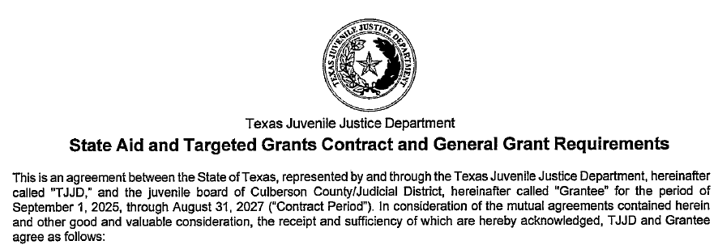
The Contract
  The Contract is an agreement between the State of Texas and your department.
  Most of the things you can and can’t do are outlined in the contract.
  Contracts are signed by each department each biennium (2-year period), in odd numbered years.
    This Biennium, also called a contract period, is from September 1st, 2025 through August 31, 2027.

Slide 4
Types of Grants
State Aid Grant
Special Programs & Other Funding
Discretionary Grants
Juvenile Justice Alt Edu Program
Reimbursement Grants

Slide 5
State Aid Grant
State aid formula funding:
Department funding is determined by several factors including youth population, history of commitments, and various needs.
Each department receives 11 payments: Double the regular amount in September, and then regular monthly payments from October until July.
Departments must have a signed state contract and enter their State Aid and Local budgets into Fluxx prior to receiving funds.
Departments must report their expenditures, issue refunds of unused money, and maintain their Local Match Requirements to ensure timely payments.
Your monthly payment will arrive in 5 checks as required by the state budget.
The list of payments to departments is available on the TJJD Website.

Slide 6
State Aid Grant: Sources
The Five Funding Sources:
Basic Probation Services (BPS)
Community Programs (CP)
Pre & Post Adjudication (PPA)
Commitment Diversion (CD)
Mental Health (MHS)
Funds are allocated from appropriations approved by the State Legislature

Slide 7
Discretionary Grants and other funding sources
Discretionary State Aid (DSA) Grant
  Requires a detailed grant proposal submitted to the Regionalization Team at TJJD.
  DSA grants are intended to meet a specific need, can focus on prevention & intervention, residential services, detention services, or community programs.
  Lump sum payments typically made at the start of the fiscal year.
Supplemental and Emergent Grant (S&E)
  Apply with your Regional Council.
  Used to cover unexpected or expanding costs.
  Paid in a lump sum by TJJD, after approval
All grant details can be found under Targeted Grants forms at https://www.tjjd.texas.gov/continuum-of-care/documents/

Slide 8
Grants: Additional Funds & Programs
Salary Adjustment Grant (SAG in FLUXX, SALADJ on payments)
Paid in a lump sum at the beginning of the fiscal year.
Increases funding for the salaries of Caseload Carrying employees, and Mental Health Professionals.
20% of this funding can be applied toward fringe costs.
PREA Audit Assistance
Pays the entire cost of a PREA Audit.
Available whenever you need to renew
Apply for these funds in Fluxx.

Slide 9
JJAEP
Juvenile Justice Alternative Education Program (JJAEP)
Helps reimburse departments that run a JJAEP for the education of kids that have been expelled from their home campus.
Students are assigned to a JJAEP program as a result of violating Texas Education Code Chapter 37 listed offenses
Two Program Types:
Mandatory: Counties with population of more than 125,000
  Monthly/quarterly
Discretionary: Smaller counties may work with their Board and TJJD to create a JJAEP program

Slide 10
Reimbursement Programs
Detention Reimbursement Program (DRA or DET): Available for youth who have been committed to TJJD, but are currently on the wait list
  To receive reimbursement, respond to our invitation in Fluxx.
  Reimburses approved detention expenses up to $150 per day (subject to change). Funding is limited and is first come first serve.
Regional Diversion Alternatives (RDA): Applies to youth placed in a facility other than the local department.
  File requests in Fluxx to receive this reimbursement.
  Usually reimburses the full amount of the program but is limited and is first come first serve.

Slide 11
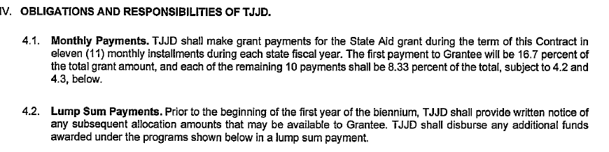
General Payment Info
To receive funds from TJJD, you must submit your budgets in Fluxx for all eligible grants.
If you have direct deposit set up with the Comptroller it goes directly into your account, if you don’t you will receive a warrant (Check) in the mail.
You can look at the TJJD website to confirm your payments.

Slide 12
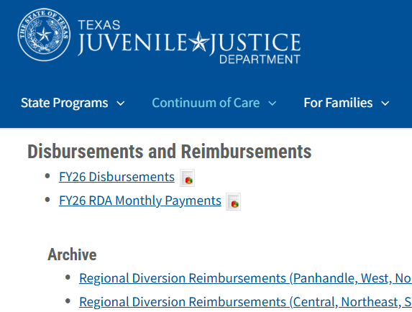
Grant Payments
Payment Schedule:
State Aid Payments: Monthly
DSA Grants: Lump Sum
PREA / S&E: On request
RDA / DET / JJAEP: Monthly (dependent on department updating placement information)
Payment information is located on our website. Download spreadsheet from the link: https://www.tjjd.texas.gov/continuum-of-care/documents/

Slide 13
Grant Payments
State Aid Total Monthly payments are broken down by funding source which should equal 1/12th of total fiscal year State Aid allocation.
  1st payment includes September and October.
  After that, payments are made a month ahead.
  No payments in August.
Because of the way this money is appropriated, your total State Aid Grant will be paid out in five separate checks, one from each of the above accounts.
See each month by clicking the appropriate tab on the bottom.

Slide 14
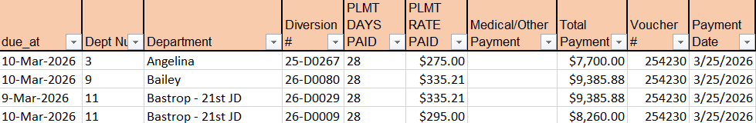
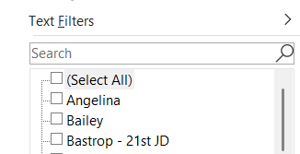
RDA Payments
Download spreadsheet from website.
Reports submitted in Fluxx are on spreadsheet and can be filtered by department or diversion number
Click the arrow next to the category you'd like to filter for easier viewing
Uncheck 'Select all' and click on your dept or diversion number

Slide 15
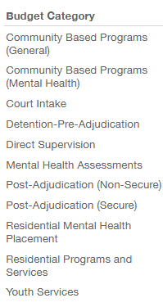
Budget Categories
Each one has a different purpose and is tied to a legislative funding initiative.​
Accuracy by departments allows us to accurately report to the LBB. Which ensures that we get the funding we need in the future.
Subcategories
Salaries & Fringe (S&F)
Travel & Training (T&T)
Operating Expenditures (OPE)
Inter-County Contracts (ICC)
External Contracts (EXC)

Slide 16
Budget Category Examples
Uniforms; if bought for staff – Court Intake, Operating Expenses.
Detention Costs; if before adjudication in a contracted facility outside of the county -Detention pre-adjudication, Intercounty Contracts
Drug testing; if for a youth who is not in care or commitment, and still in the community -Youth Services, Operating Expenses.

Slide 17
FYI
Some of the Funding Sources and Budget Categories have overlapping or similar names; this is coincidental and does not impact your budget and or the amount in each category
For example, you may receive a $5,000 check for Community Programs. This DOES NOT mean you need to spend $5,000 in the Community Based Programs category in your Fluxx budget

Slide 18
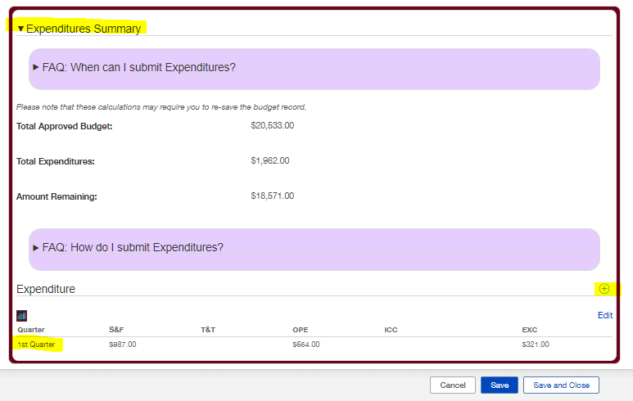
Expenditure Reporting
Entry Window
Q1: 12/1 - 1/15
Q2: 3/1 - 3/31
Q3: 6/1 - 6/30
Q4: 9/1 - 9/30

Slide 19
Expenditure Adjustments
Edit your adjustments as much as you like before they close for approval.
If you notice a mistake after the Quarter closes, fix it in the following Quarter.
Adjustment Period:
  After Q4 (EOY) – 15 days (October 1-15)
    Accuracy of annual total most important.
Missed reporting that is not resolved by EOY will be considered unexpended funds

Slide 20
Other reports we collect
Certification of Local budget expenditures: the final check on local spending for the year.
  Reported in Fluxx
  Can only be certified by the JPD Chief.
  Important because the total expenditures at the local level impacts your local match calculation.
End of Year Reports: Balancing of the books
  Complete the reconciling of all grant budget and expenditures.
  Must be completed by October 1st.

Slide 21
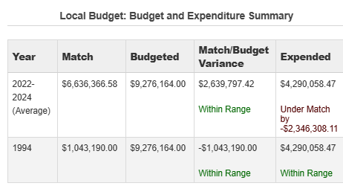
Local match
Probation Departments are required to contribute a portion of their operating costs. This budget is contributed by their county, or counties.
The state requires that each JPD meet their local match, which is calculated by the department budget from both 1994, and a rolling total from the last three fiscal years. You can check your local match in Fluxx on the local budget card.

Slide 22
Refunds
Any unspent grant funds are to be refunded to TJJD.
Due by Nov 1st
Include on the refund check:
  Fiscal Year
  Grant Name
Mail to:
Texas Juvenile Justice Department
Attn: Fiscal – County Grants
PO Box 12757
Austin, TX 78711

Slide 23
Independent Audits:
Checks and Balances
Each department shall contract an independent financial Auditor.
Templated guidance for the Independent Audit is updated yearly and available on our website.
Must be completed by March 1st of the following fiscal year.
Email a copy of the report to: <Probation.Independent.Audits@tjjd.texas.gov>
You may receive an Audit Waiver; Audit waiver eligibility is determined by the following:
  If your State aid Grant is $750,000 annually or less, Previous independent audits, Reporting timeliness.
  Depts who are eligible to receive a waiver will be notified via email by TJJD by November 1st

Slide 24
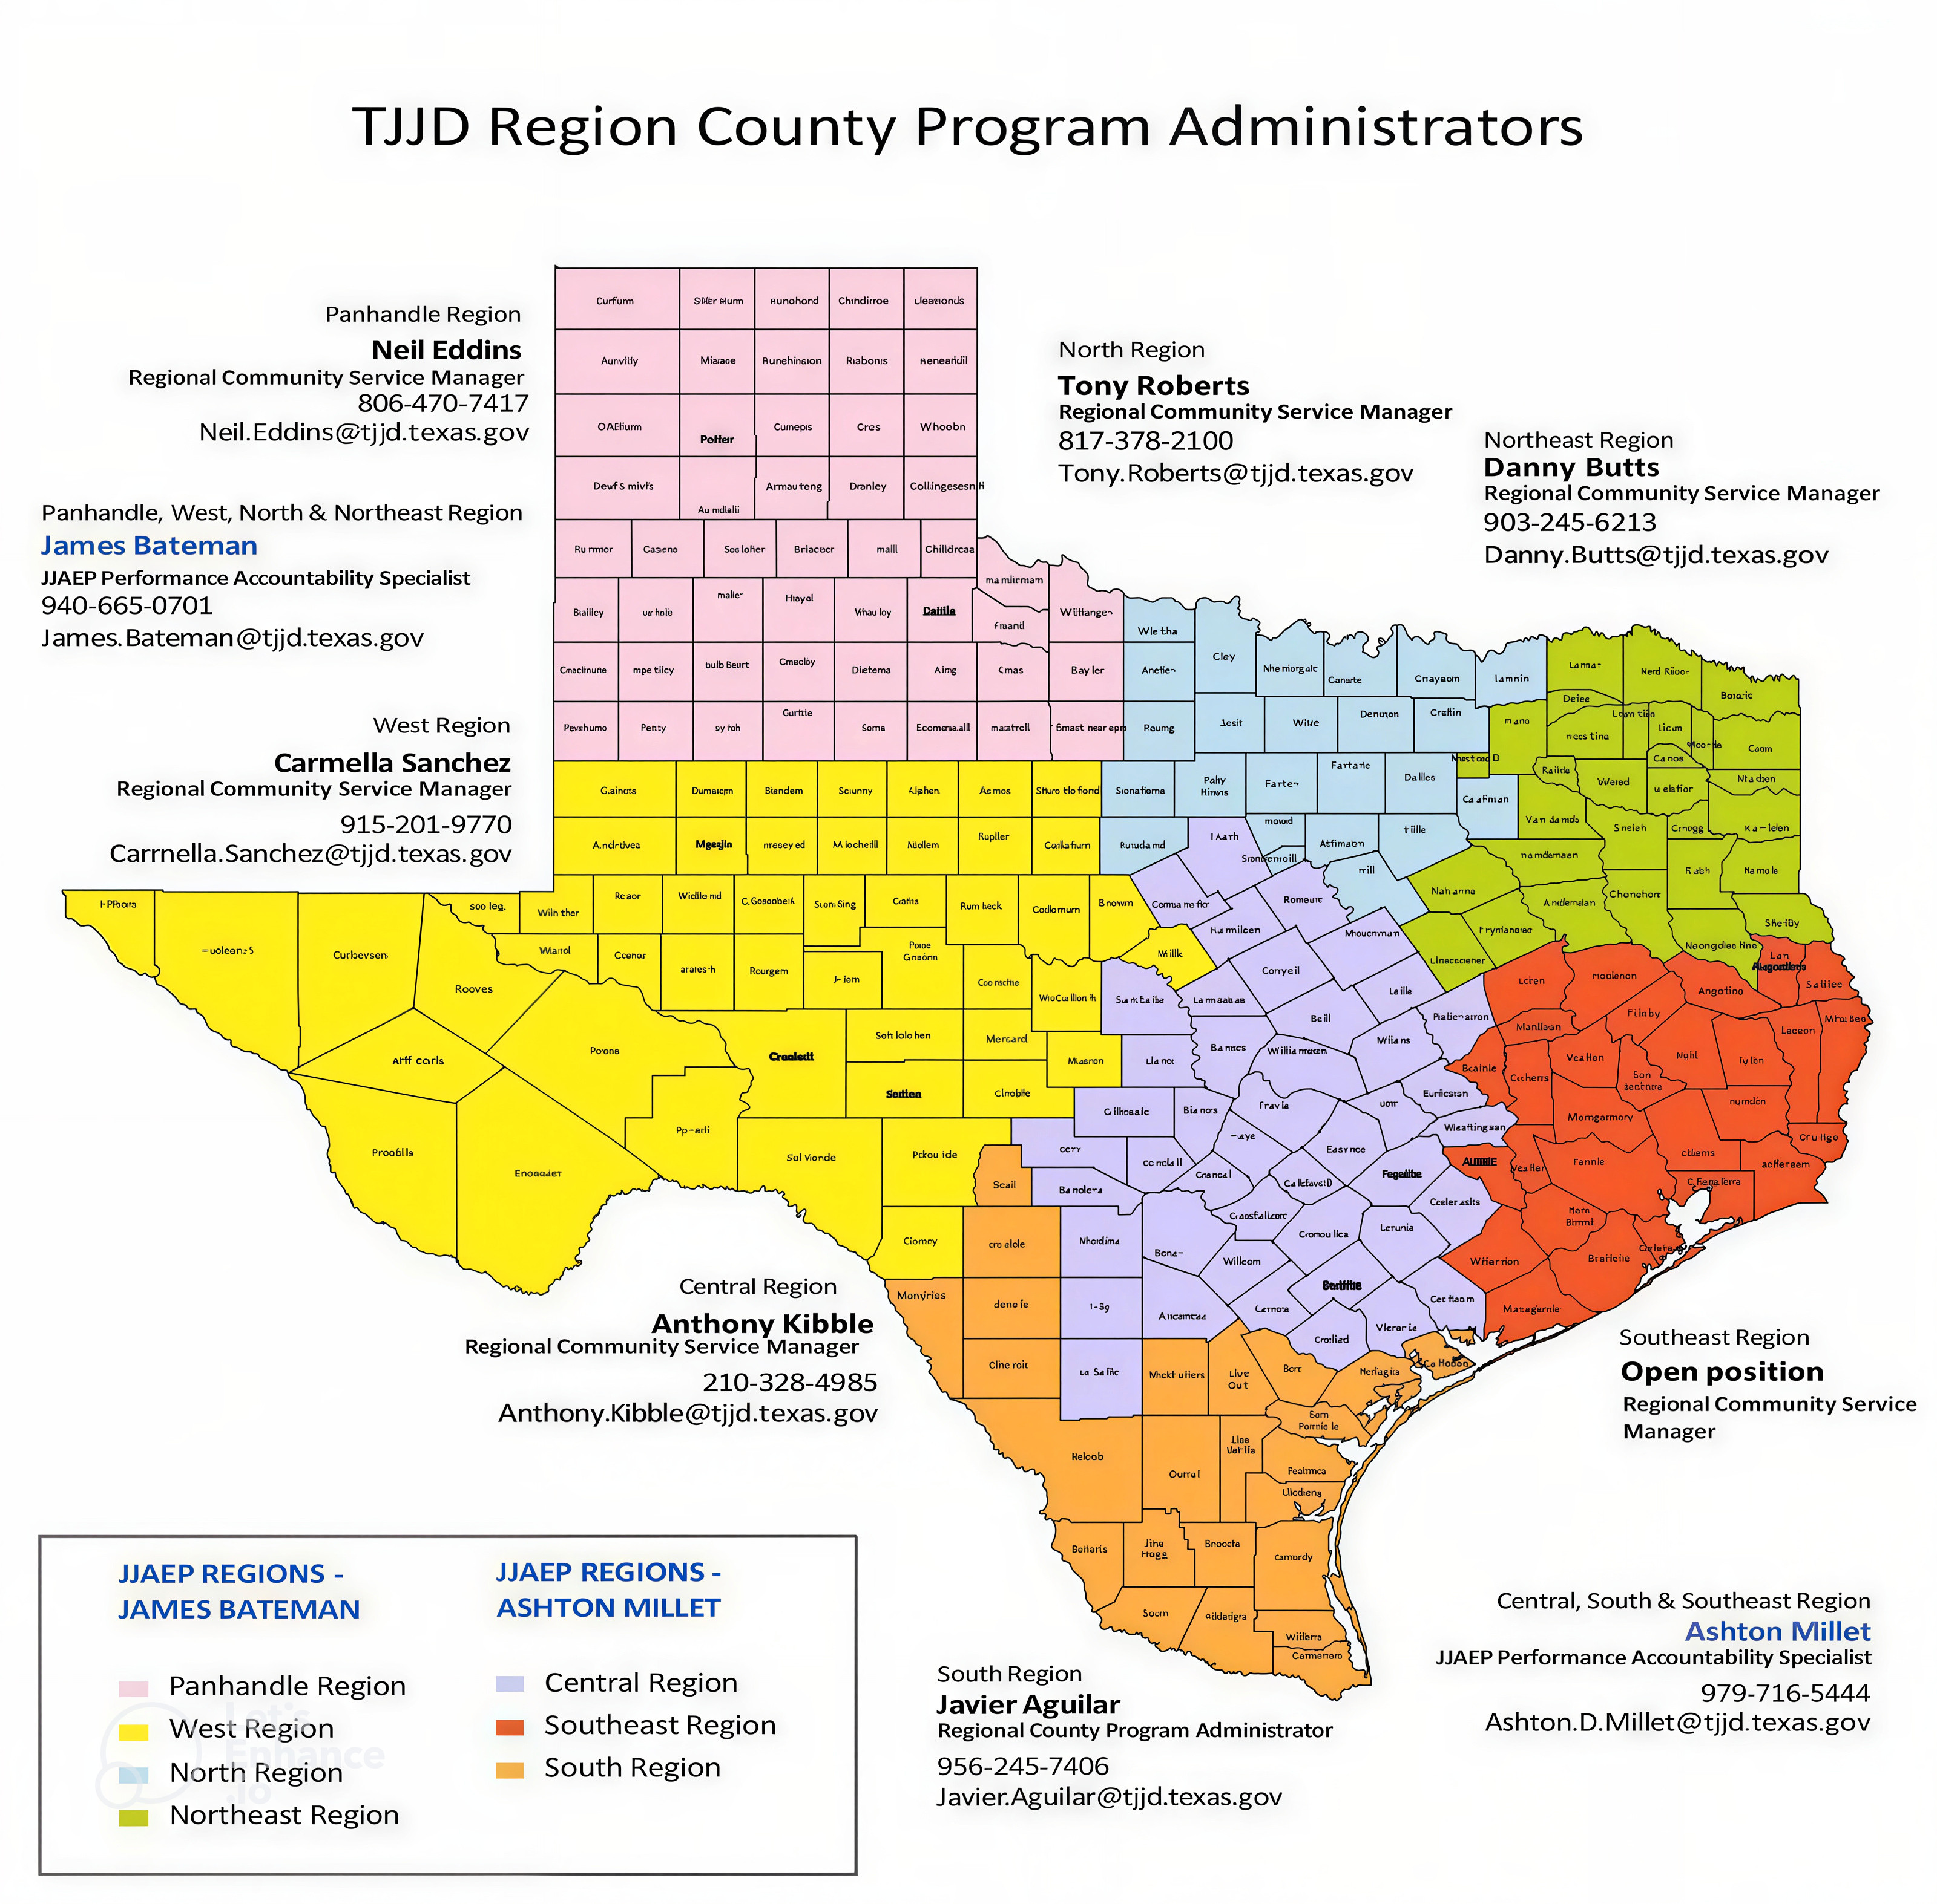
Regional Community Service Managers

Slide 25

Questions

Slide 26
How to FLUXX

Slide 27
What Can I Do In Fluxx?
Create – Review – Submit – Adjust – Track:
Applications
Budgets
Expenditures
Grant Details
Make Special Requests
Request Budget Adjustment Amendments
Reports & Documents
This is a live program and updates are
rolled out as needed.

Slide 28
How to request Access to Fluxx
Step 1. Download the “TJJD Grants Portal User Authorization Request (Juvenile Justice Departments)” from this link https://www.tjjd.texas.gov/wp-content/uploads/2026/02/TJJD-Grants-Portal-Fluxx-Access-Form-3.pdf
Step 2. Complete the top section with information about the new user.
Step 3. Choose one “User Role” and one or more “Programs” based on the access the new user needs.
Step 4. Sign the form to authorize, both the person requesting access, and the Chief of the JPD.
Step 5. Scan and send the form to CustomerSuccessTeam@tjjd.texas.gov or attach it to a new ticket in the IT Business Support portal.

Slide 29

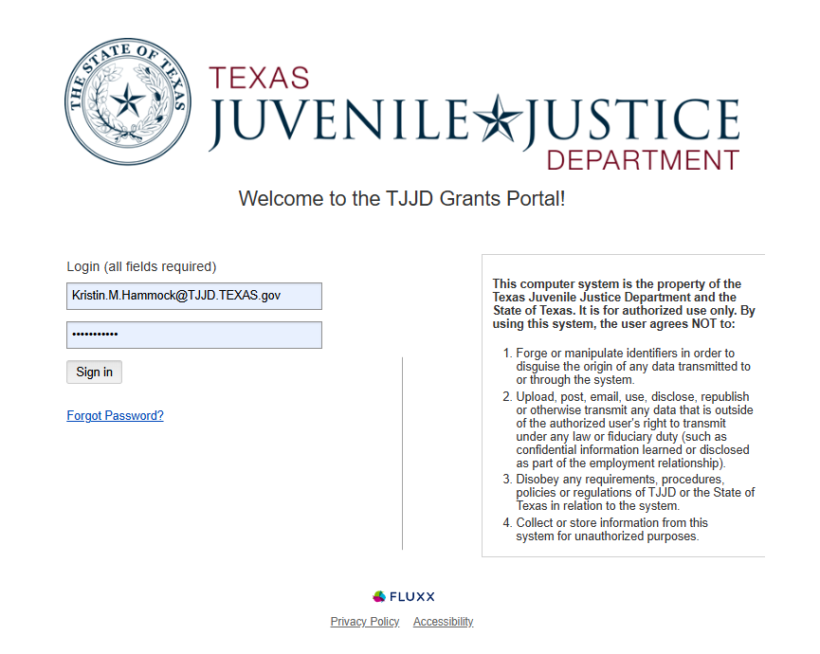
Logging in to Fluxx
Type the website into your browser window.
Enter your username and password.

Slide 30

Navigating Fluxx
Dashboard
Need Help?

Slide 31
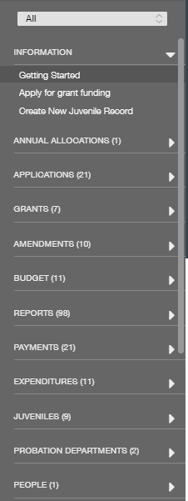
Dashboard
Big Gray Bar on the Left
Navigation – collapsible sections.
The number floating after the titles here tell you how many you have in each section
Can toggle between departments if you have more than one or show all at once.

Slide 32
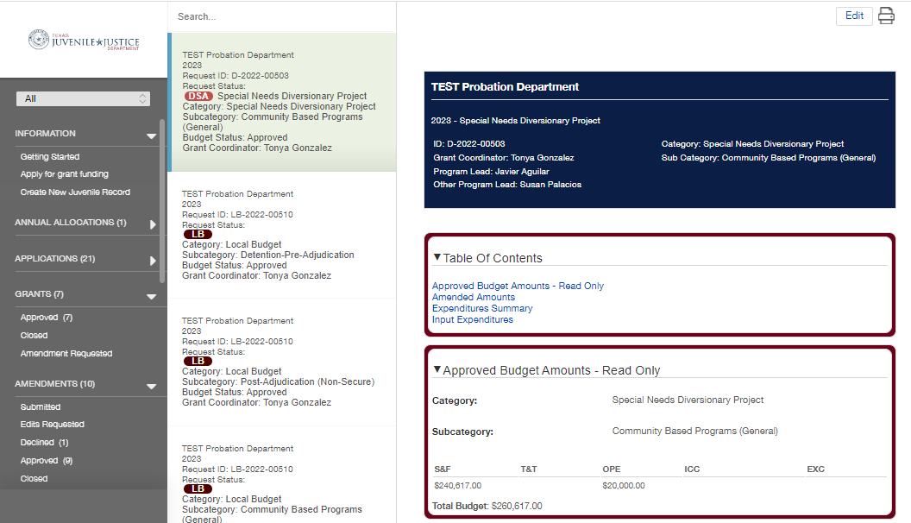
Cards and Card Details
Cards
Background turns green when selected
One for each Grant
Card Details
Gives detailed information.
Cards and Card Details change depending on the section you are in.
Often editable

Slide 33
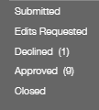
Statuses
Submitted – The card has been sent to us for review
Edits Requested – We have reviewed the card and determined something needs to be corrected.
Declined – The card has been declined.
Approved – The card has been approved.
Closed – These cards has been closed (previous fiscal years or paid “reports”).

Slide 34
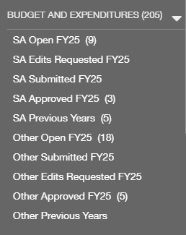
Budgets
SA: relate to State Aid
Other: relate to all other budgets (Local, DSA, etc.)
Numbers in parentheses indicate number of budget categories in that status.
Cards will move to different statuses depending on changes made, such as BARS, submitted expenditures, etc., but will mostly live in Approved.

Slide 35
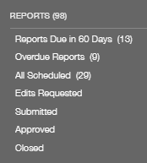
Reports
Reports could be a variety of information we need from a department. Such as End of Year Reports, quarterly reports, or monthly Reports for Reimbursements
Reports Due in 60 Days – indicates number of reports in this status. No number means no reports are due within 60 days. Check here regularly.
Overdue Reports – Deadline has passed and needs to be submitted as soon as possible.
All Scheduled – All reports that have been assigned, regardless of length of time before due date.
Edits Requested – Submitted report needs correction. Check here regularly.
Submitted – Reports that have been have submitted, by the department.
Approved – Reports that have been reviewed and approved by TJJD Staff.
Closed – No longer under review or no longer needed.

Slide 36
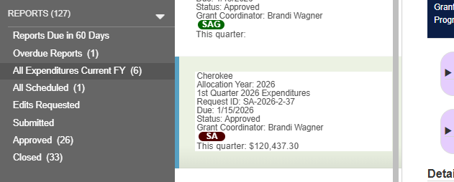
Expenditure Reports
Expenditures must be reported quarterly on every grant.
If you haven't expended any funds from that Grant, enter 0s on the report and submit.
To view your previous expenditure reports;
On the dark gray bar on the left of the screen choose REPORTS (##)
For the current fiscal year choose All Expenditures Current FY
For previous fiscal years choose Approved or Closed
Then choose the one you want to look at
from the drop down just to the right of the gray bar.

Slide 37
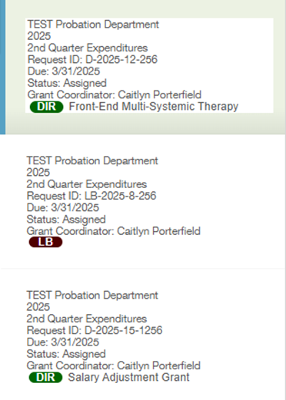
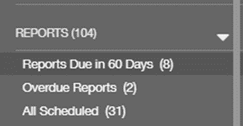
How to report Expenditures
Note: Expenditure Entry periods are during the following time frames.
Q1: 12/1 – 1/15 Q2: 3/1 – 3/31 Q3: 6/1 – 6/30 Q4: 9/1 – 9/30
Choose Reports in the gray bar, and then choose the option for "Reports due in 60 days"
  Choose the card for the grant/budget to enter expenditures in. The background of the card will change to a light green when selected and its information will populate on the right side of the screen.

Slide 38
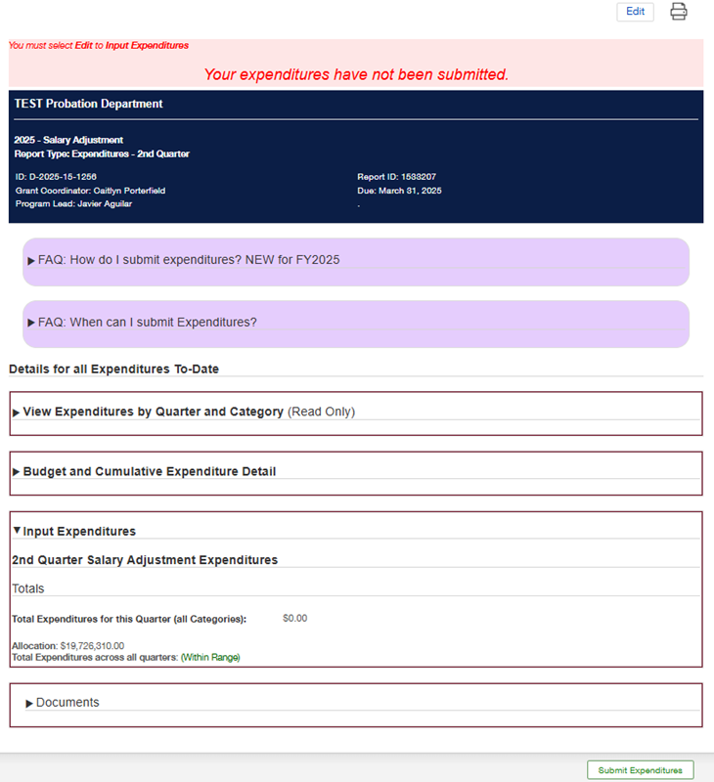
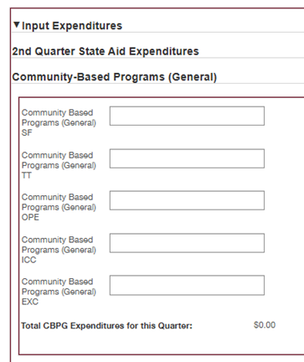
How to report Expenditures
This is the Expenditure to date record, it lets you
know what has been entered so far.
To enter new expenditures, you first need to click the edit button up next to the printer Icon in the far-right corner.
Enter the dollar amount spent in each of the categories and subcategories that you spent money in.

Slide 39
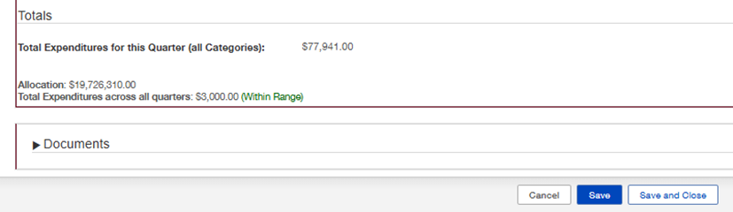
How to report Expenditures
This form doesn't save automatically! Remember to hit the save button at the bottom right of the form each time you edit this report.
When you save, the total expenditures for this quarter number will update, and you can use it to check your work.
When you are sure you have finished your report choose the Save and Close option.
Click the "Submit Expenditures" button on the bottom right of the screen to submit.

Slide 40
How to edit Expenditures
  During expenditure entry periods, log into Fluxx and navigate to the Reports section of the Dashboard.
  Choose the Submitted link to see what reports have been submitted.
  Note: The Submit Expenditures button will not be available when editing a submitted report, but simply a button with a period in it, which may be ignored. Clicking Save and Close is sufficient and editing expenditures can be done as often as necessary until the expenditure entry period closes. Once closed, the reports will be locked and all adjustments will need to be made in the next quarter.
EXCEPTIONS: Exceptions to the above guidelines would be:
  Q4 – Q4 expenditures are reported on an accrual basis, meaning that expenditures should be entered, taking into consideration any outstanding invoices they know are coming for expenses/services rendered on or prior to August 31st. Therefore, any known invoices, purchase orders, and assumed incoming reimbursements should be accounted for in the Q4 expenditure entry.

Slide 41
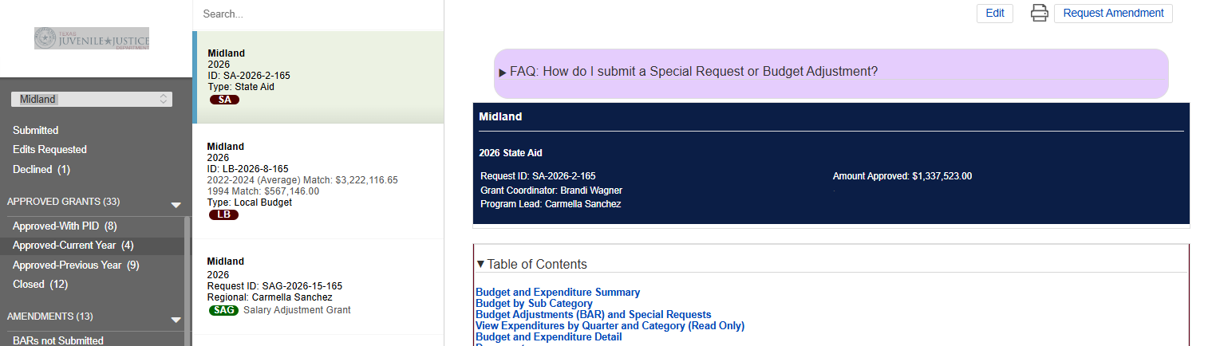
Special Requests
Special Requests are for when you need to allocate money for out of state travel, or your need to make a purchase of goods or services that is more than $10,000 total.
You make the request in Fluxx, we edit it, and your Regional Admin reviews and approves it, then we let you know that you're approved.
Go to Approved Grants -> Choose your SA Grant -> Choose Request Amendment

Slide 42
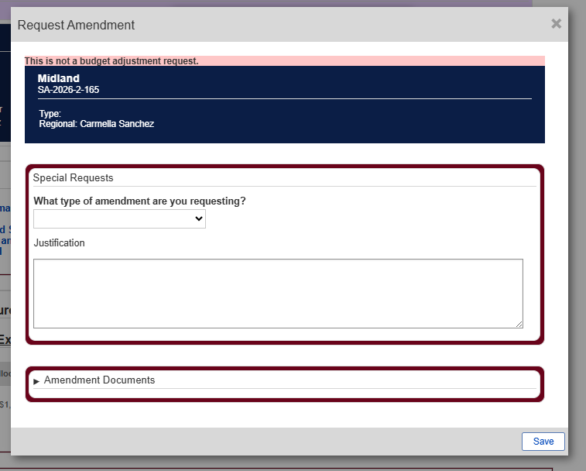
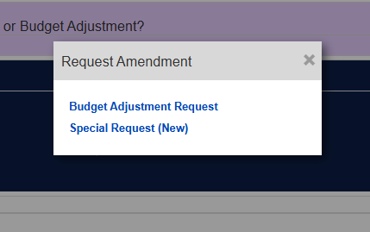
Special Requests
Next choose Special Request
From the drop down you pick the option you need. Then write out the justification. Be specific, this what we send to your CoSM for approval. Don't forget to SAVE.

Slide 43
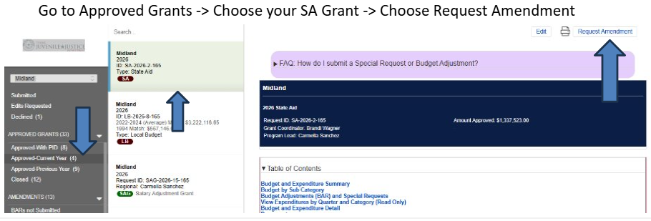
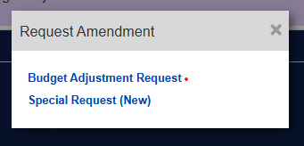
How Request a Budget Adjustment
Just like with special requests;
Then choose the option for Budget Adjustment

Slide 44
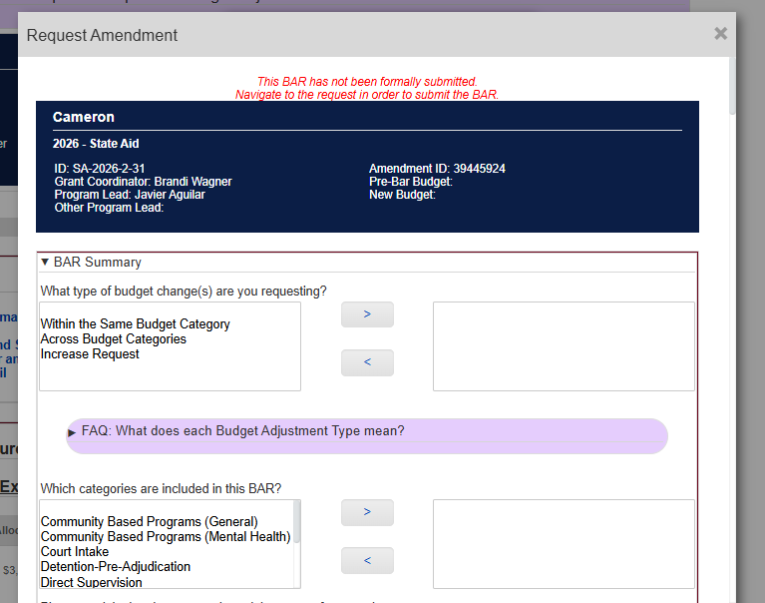
Budget Adjustment Requests
Confirm you are adjusting the right budget, in the right Grant in the big dark blue box.
Under BAR Summary; choose the kind of change you are requesting.
Under which categories; choose all the categories you are moving money from, and to.

Slide 45
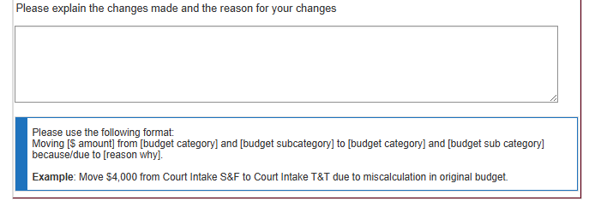
Budget Adjustment Requests
In this box, explain what you are moving and why. The explanation is mostly for your notes, and you can put anything. The money movements, as written in the included example, are so that we can make sure that your changes are what you intended.

Slide 46
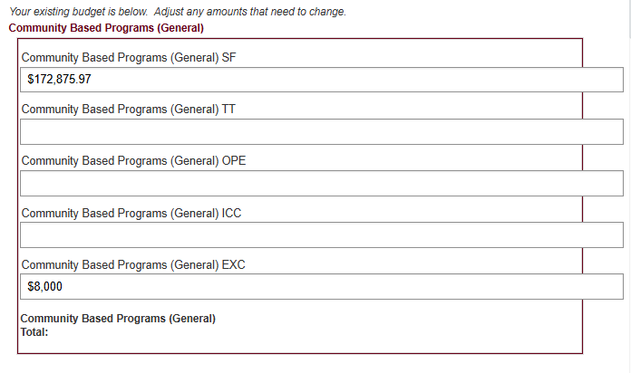

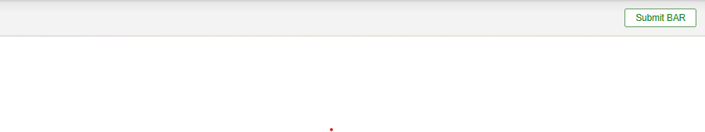
Budget Adjustment Requests
Below the notes, you will find each category laid out. Including the amounts currently in each subcategory. Subtract what you want from each and add it to the categories that you want to add too.
Every cent must be allocated, so if your math is off, you will receive a warning when you try to save.
When you finish hit save. And then choose Submit BAR at the bottom right of the screen.

Slide 47
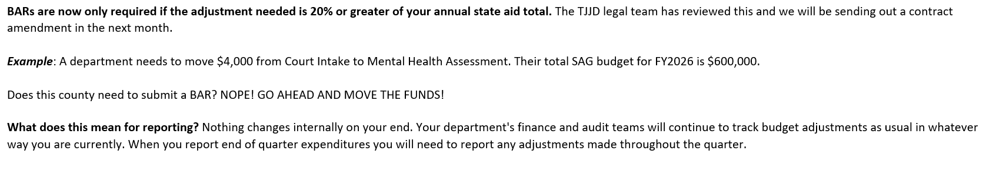
New: Budget Adjustment Request Policy
Effective 2/1/26: If you are moving less than 20% of your TOTAL state aid budget for the year, you do not need to submit a BAR in real time in order to move that money from one spending category to another
**You will need to track these changes internally so that you can reconcile your budget and expenditures at the end of the fiscal year
  This means BARs will need to be submitted eventually, but they can be consolidated to reflect all changes made that were less than 20% of your budget throughout the year rather than waiting for TJJD approval to move smaller amounts between categories
If you prefer to have your budget reflected accurately in FLUXX as you make any changes, you still have the option to submit BARs for all budget adjustments as they happen.

Slide 48
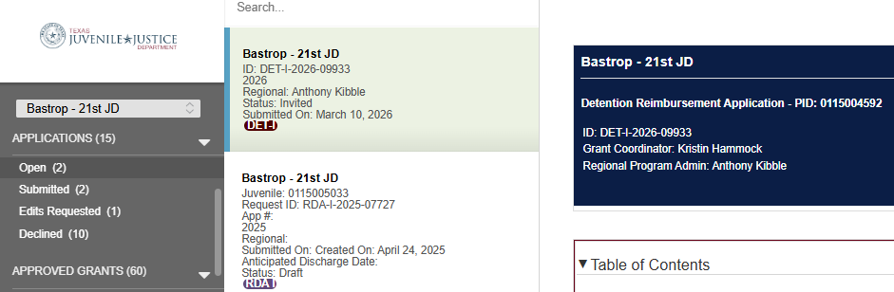
Detention Reimbursements
To file your request for DET-I, first you have to respond to the open application. Under Applications choose OPEN, and then click on the application you want to follow up on. Detention Reimbursments will have DET at the bottom and in the ID.

Slide 49
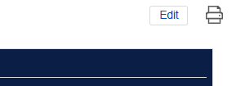
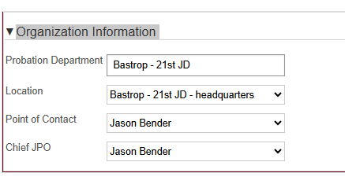
Detention Reimbursements
Choose the edit button up on the right hand corner of the window. It hides next to the tiny printer button.
Check the information in the organization box and make sure that it's all correct, and if not edit it so that it is

Slide 50
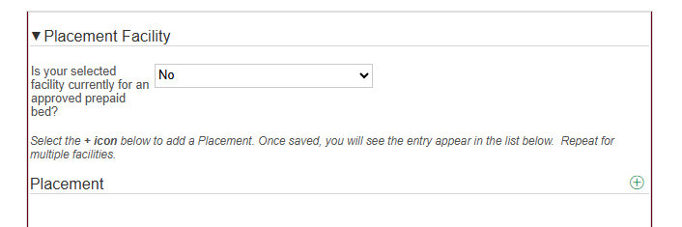
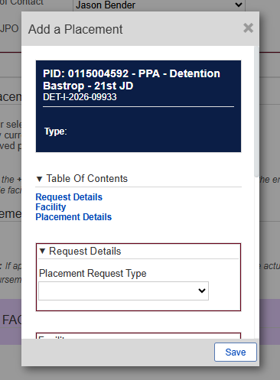
Detention Reimbursements
In the placement window click on the tiny green circle in the lower right
When you do, you'll get a small pop-up window.
Under Request Details, there is a drop down under Placement Request Type, choose the only option, PPA – Detention.

Slide 51
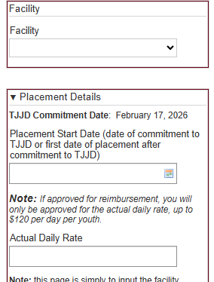
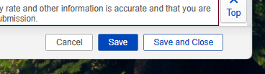
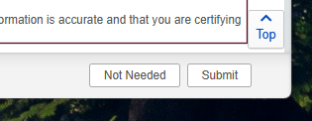
Detention Reimbursements
Fill in each of the drop downs in the window. If you need to add additional placements just repeat the process.
When you have it set, choose the save and close option.
On the bottom left of the screen, click Submit.

Slide 52
RDA Process
RDA placements must be applied for with a requested reimbursement rate, number of days, and supporting documentation
  The application, review, and verification process happens prior to submitting reimbursement reports
Today, we will focus on the reimbursement process that happens once a placement is approved

Slide 53
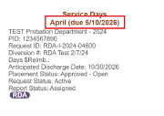
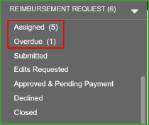
RDA Reporting – Service Days
Monthly reports must be submitted to receive reimbursement. These open on the first, are due by the 10th of the month, and are for the service days from the previous month
Navigate to the Reimbursement Request menu under Assigned and/or Overdue
Select the relevant report and select Edit

Slide 54
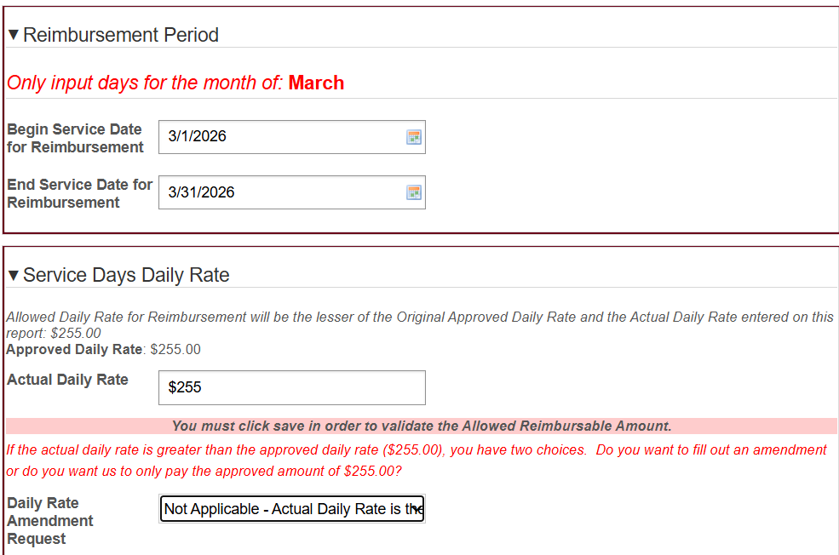
RDA Reporting – Service Days, no Amendments
Input Reimbursement Begin and End Date
Input Actual Daily Rate
  See next slide if you're requesting a daily rate change
Save the report, verify all information for accuracy, then click Submit for Reimbursement

Slide 55
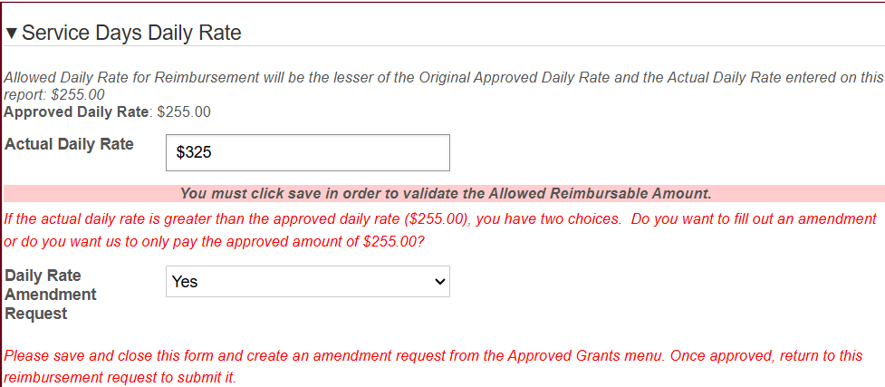
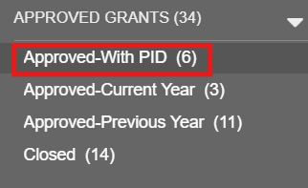
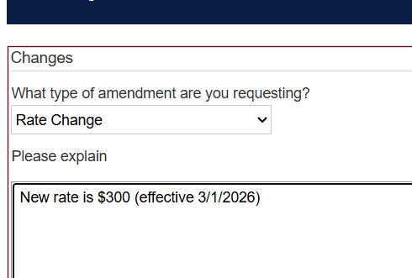
RDA Reporting – Service Days, with Amendments
If you answer Yes to the Daily Rate Amendment Request, there are a few extra steps before submitting for reimbursement
  Save this report
  Go to Approved Grants - Approved-With PID and select the placement you'd like to amend
  Click Request Amendment at top right corner, click RDA Amendment
  Select Rate Change and write an explanation, then Save
  Submit by the 5th of the month to allow time for approval before reports are due on the 10th
Once approved, go back into the Reimbursement Report
  You should see the new Approved Daily Rate updated to match the Actual Daily Rate
  Submit Reimbursement

Slide 56
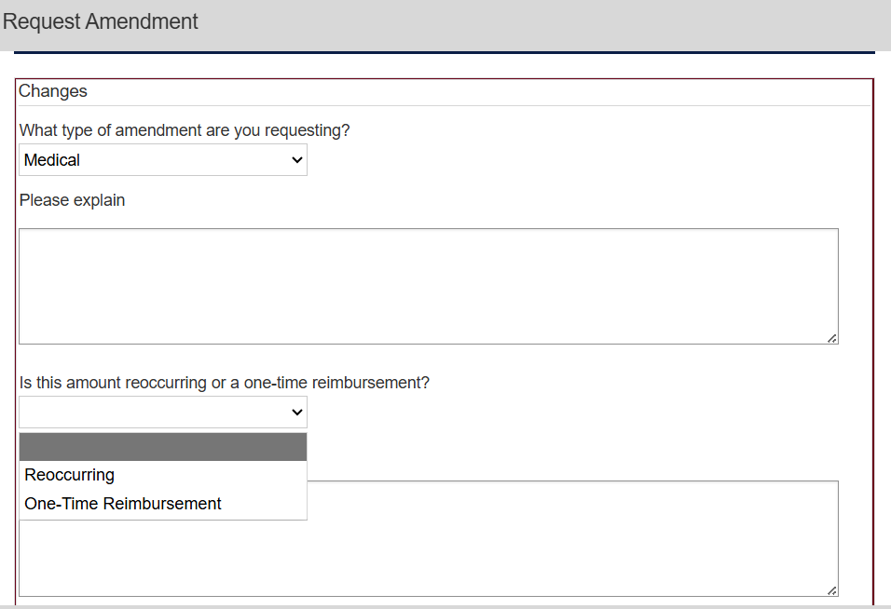
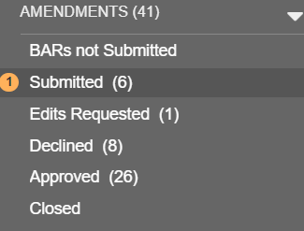
RDA Reporting – Other Amendments
Request an amendment using the same steps for:
  Placement extension
  Placement change
  Aftercare
  Travel
  Medical services
Select the appropriate Amendment Type and write an explanation
If applicable, select if this is a one-time or recurring charge

Slide 57
RDA Reporting – Non-service Days
Once an approved amendment is in place, medical, mental health, or other non-service day charges for an RDA placement are added to a continuous report
Once the sum of charges reaches $500, the report will be eligible to submit
  Other eligible situations, regardless of total $:
    Final report for a youth who has been discharged
    End of the fiscal year (September 10th report for August dates of service)
Submit these by the 5th of the month for prompt reimbursement

Slide 58
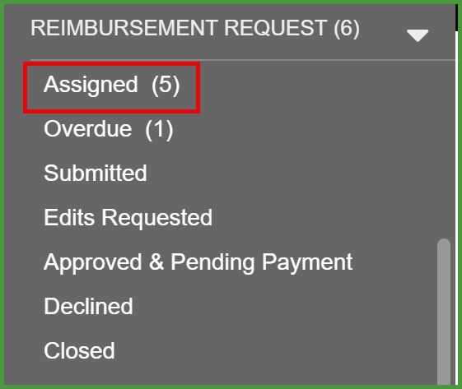
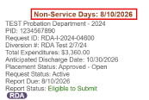
RDA Reporting – Non-service Days
Reimbursement Request menu
Non-Service Days Reimbursement Request
Edit

Slide 59
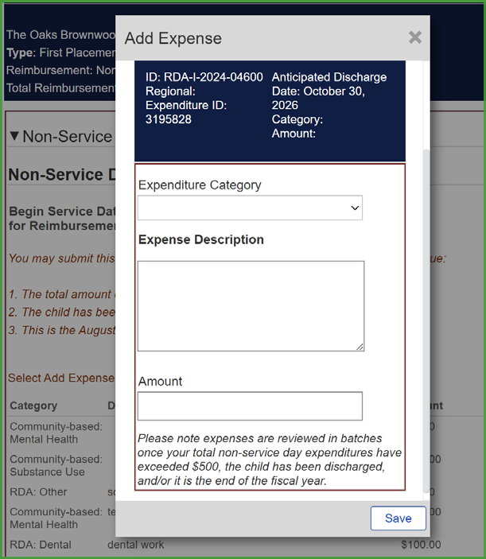

RDA Reporting – Non-service Days
Add Expense
  Choose category that fits best
  Enter brief description for charges
Save pop-up, confirm that you see it added to the running list
Submit if eligible

Slide 60
Tips for RDA Reports
Some common mistakes that can delay reimbursement include:
  Entering the wrong dates
  Submitting after the 10th of the month
    5th for Daily Rate Changes or Non-Service Day reports
  Not entering the Actual Daily Rate or leaving items blank

Slide 61

Brandi Wagner
County Grants Fiscal Manager
512-596-7982
Brandi.Wagner@TJJD.Texas.gov
Kristin Hammock
County Grants Fiscal Administrator
512-466-2229
Kristin.M.Hammock@TJJD.Texas.gov

