Slide 1
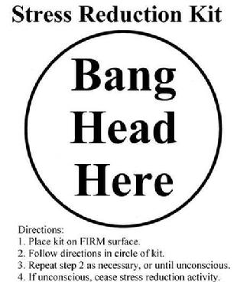
STOP BANGING YOUR HEAD
A Performance Improvement Strategy
Juvenile Justice Training Academy
Texas Juvenile Justice Department
11209 Metric Blvd., Bldg. H, Suite A
Austin, Texas 78758
www.tjjd.texas.gov

Slide 2
Thoughts on the video…
Write down what you think about the video:
NOTES
Do you really need your time off from work?
What are your priorities?
Juvenile Justice Training Academy
www.tjjd.texas.gov

Slide 3
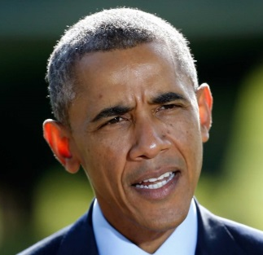
NOTES
Being President can be a tough job.
Explain the four categories of stressors and effects related to employment as a juvenile justice professional.
Learn the Six Stage approach to improving workplace wellness.
Explain the prevention and response strategies needed to support health and wellness in the workplace.
In an action plan develop at least two strategies that you will begin to use to reduce your own stress using what you have learned.
PERFORMANCE OBJECTIVES
The four categories of workplace stress in the juvenile justice field are related to youthful offenders you work with, the type of facility environments officers find themselves, organizational/administrative in nature and finally psycho-social.
Juvenile Justice Training Academy
www.tjjd.texas.gov

Slide 4
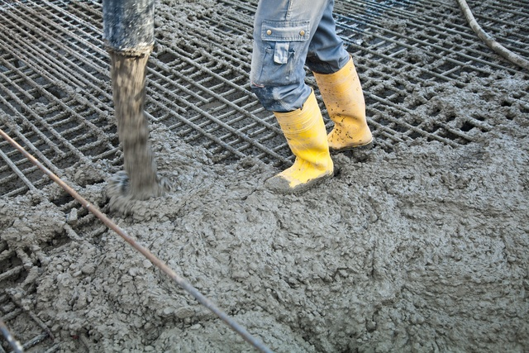
The dangers associated with the work you do is real and amplified by the physical environments and communities that you work. These individuals are at times uncooperative, impulsive, angry, manipulative and under the influence of different destabilizing substances.
NOTES
There is a constant need to be hyper vigilant and maintain professional boundaries. The dual role to maintain supervision and at the same time being asked to maintain rapport and a therapeutic relationship can be a stress as well.
Environments
Juvenile Justice Training Academy
www.tjjd.texas.gov

Slide 5
Organizational and administrative factors that determine how well the department is run can add stress. Common organizational stressors can include inadequate training, office politics, shift work and assignments, heavy work loads, lengthy internal investigations, excessive disciplinary actions a lack of administrative support and leadership. High caseloads, paperwork and having too many competing deadlines can be stressful. Mandatory overtime, conflicts with your direct supervisor and not having to resources you need to get the job done can also make officers feel overwhelmed. Perceptions that the departments does not trust and support staff or managerial practices that appear mismanaged and grounded in poor decision making can add to job dissatisfaction. Finally, an employee that feels like they do not have input or any job autonomy can experience increased levels of stress.
NOTES
Juvenile Justice Training Academy
www.tjjd.texas.gov

Slide 6
These can be differences in fear on the job, level of aggression and how much rapport or charisma a single officer may have. Work-family conflicts which are defined as conflict that arises when the roles of work and family are mutually incompatible can be caused by features of the job including shift work, dual roles at work and at home, chronic fatigue, cynicism, pessimism, sarcasm and exposure to trauma and other behaviors. A final external stressor is how the public perceives the job and how this can be inappropriately influenced by the media.
NOTES
Who might be watching you in the community?
Juvenile Justice Training Academy
www.tjjd.texas.gov

Slide 7
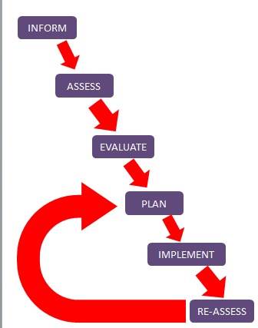
NOTES
Effects of the Four Categories:
The “Six Stage Solution Model” is a reliable
way for a workplace to structure their
response to employee stress. The model
can help your department capitalize
on existing capabilities in the realm
of assessment on the front end,
coupled with a cyclical process
of systematic trial and error
on the back end, reflects a
prudent strategy.
Juvenile Justice Training Academy
www.tjjd.texas.gov

Slide 8
NOTES
What can you do to prevent stress?
Juvenile Justice Training Academy
www.tjjd.texas.gov

Slide 9
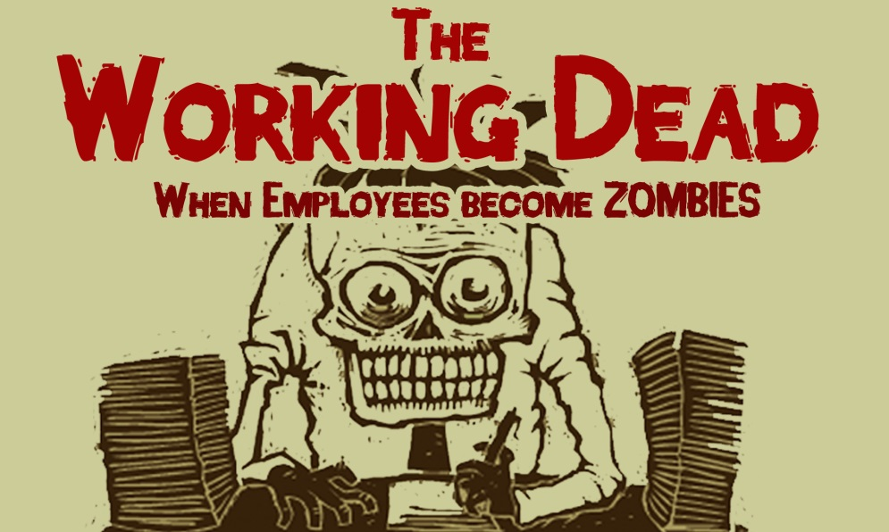
NOTES
Responding to active stress.
When prevention is not working.
Juvenile Justice Training Academy
www.tjjd.texas.gov

Slide 10
NOTES
HUMOR
AT
WORK
Juvenile Justice Training Academy
www.tjjd.texas.gov

Slide 11
Thank you for your active participation today. Please help us to provide beneficial training experiences in the future that will help you in the work that you do. Complete any evaluations and provide suggestions for future training that you would like to see created and provided.
Juvenile Justice Training Academy
www.tjjd.texas.gov

