Slide 1
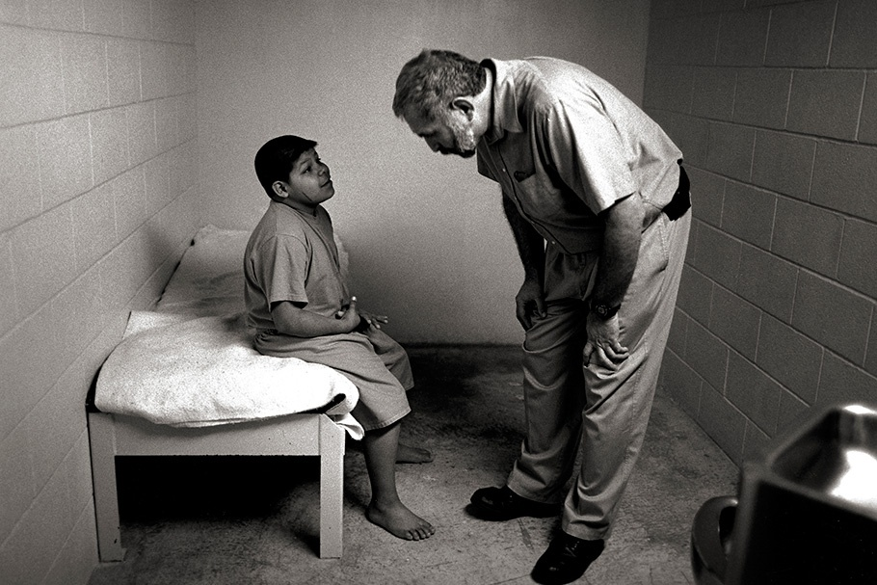
Rapport: Making the Supervision Connection
A presentation by the Juvenile Justice Training Academy
11209 Metric Boulevard, Austin, TX 78758
www.tjjd.texas.gov

Slide 2
Any presentation or training you attend takes work by both the trainer and the participant. To get the most out of this webinar experience please take a moment to read the following suggestions.
Remember that you are responsible for your own learning. During the webinar you can ask questions by raising your hand or typing. This handout is for your benefit. Follow along as the webinar progresses.
Ground Rules
Be Focused
Be Prepared
Be Positive
Be Productive
Follow along in your manuals
Texas Juvenile Justice Department
www.tjjd.texas.gov

Slide 3
Performance Objectives
Participants will be able to:
Learn the value of creating positive relationships with youth they supervise.
Learn how to build positive working relationships.
Develop an “Action Plan” to promote trust based rapport using what they learned during the presentation.
Notes
Building our Connections
Agenda
Build Trust
Build Confidence
Build Skills
Build Others
Texas Juvenile Justice Department
www.tjjd.texas.gov

Slide 4
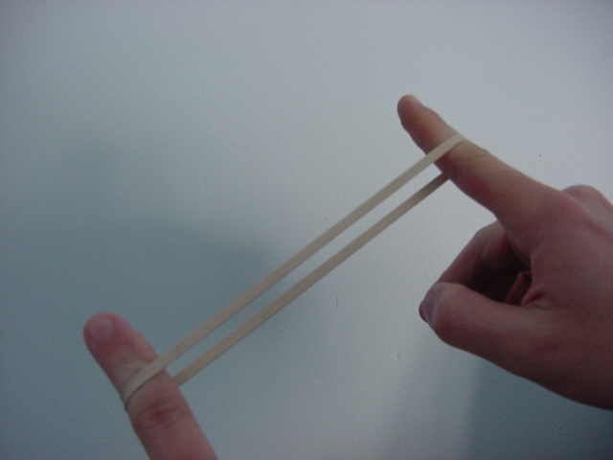
Building Trust
Notes
How long will you hold on?
Using the scale rate yourself on each question below.
Never Seldom Sometimes Often Always
1 2 3 4 5
Am I quick to respond to other’s needs?
Do I run from problems or face them?
Do I talk more about bad news or good news?
Do I give people the benefit of the doubt, or do I assume the worst?
Do I treat people consistently?
Texas Juvenile Justice Department
www.tjjd.texas.gov

Slide 5
Notes
How do each of the questions connect to building trust with the youth supervise?
Can you make improvements in areas that you rated yourself lower?
What do your ratings and these questions connect to?
Your ____________________
The Golden Rule
Texas Juvenile Justice Department
www.tjjd.texas.gov

Slide 6
Playing Catch
Notes
A wealthy woman was concerned about her son and the fact that he did not wish to take over his father’s business. The son in fact refused to take on the responsibility upon his father’s death. This woman sought the help of the best counselors money could buy and in the first session the son, still very opposed to entering his father’s business, explained why. The son said that his father grew up in a time where self reliance was a lesson that his father learned the hard way and that the father believed the son should learn self reliance as well. The father’s method for doing this was to never encourage or praise his son. Even when they did something together, the father used this as a teaching moment that had left him feeling angry and frustrated. When they would play catch, the goal was the son had to catch ten balls in a row and on the tenth throw his father would do everything he could to prevent the son from making that tenth catch. He never made that tenth catch! This left him feeling he could never be perfect or measure up to his father’s expectations and the reason why he does not want anything to do with a business where you can never meet expectations.
Texas Juvenile Justice Department
www.tjjd.texas.gov

Slide 7
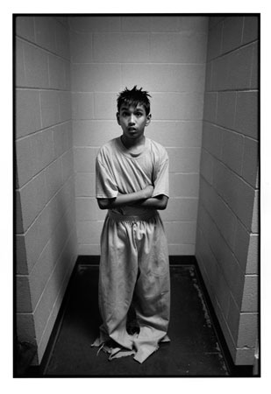
Does your supervisor always communicate the rules and expectations they have for you?
How often have you rushed to judgement before you have been able to get to know a youth?
How often are you surprised when what you initially believed about a youth did not match up with the real person once you took some time to get to know them?
Notes
Texas Juvenile Justice Department
www.tjjd.texas.gov

Slide 8
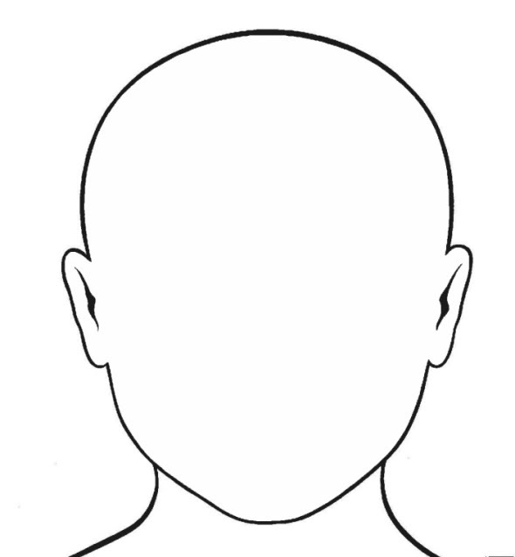
Five ways we want others to treat us…
Notes
You want others to _______________ you
You want others to appreciate you
You want others to _______________ you
You want others to _____________ to you
You want others to understand you
Texas Juvenile Justice Department
www.tjjd.texas.gov

Slide 9
Notes
Items
1.
2.
3.
4.
Did I leave out anything on my list?
Texas Juvenile Justice Department
www.tjjd.texas.gov

Slide 10
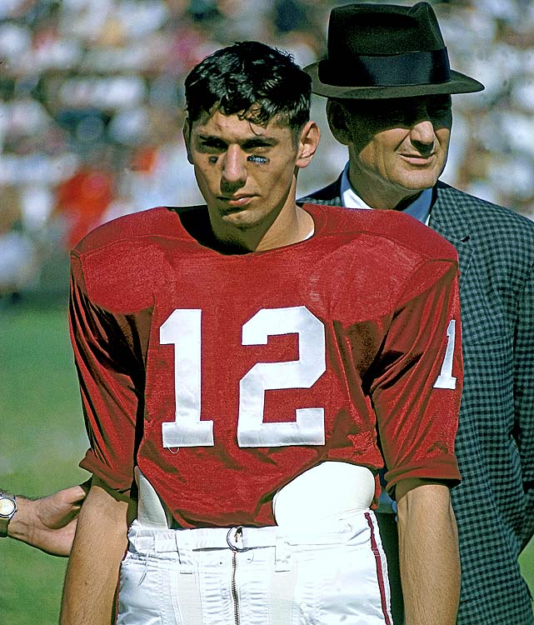
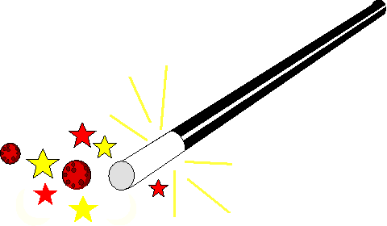
Notes
Important words from the old coach!
Building trust is the foundational piece to building positive working relationships.
Building Confidence
_________________
Texas Juvenile Justice Department
www.tjjd.texas.gov

Slide 11
Roadblocks
to
Charisma
Notes
______________ : a tendency to look down on other people, feeling a sense of superiority.
______________ : not willing to take a risk. Preferring to remain comfortable and unexciting.
______________ : immature and undependable quality, fickle and sullen.
______________ : obsessive need to perform flawlessly. Stifles creativity and turns people away.
______________ : constant need for self reflection and not aware of other’s needs.
______________ : the opposite of charisma, depressing to be around and saying no to life in general. There is no way to be a charismatic leader when no one wants to be around you.
Texas Juvenile Justice Department
www.tjjd.texas.gov

Slide 12
T Tell them it takes time.
E Expose yourself to their problems in order to relate to them.
A Assure them of your confidence in them.
C Creatively show them how to deal with their problems.
H Offer hope to them through the process.
Notes
Be a Confidence Builder!
A man lived by the side of the road and sold hot dogs. He was hard of hearing so he had no radio. He had trouble with his eyes so he read no newspapers. But he sold really good hot dogs. So good in fact that he made enough money to send his son to college. He just stood there on the side of the road yelling “Buy a hot dog!” People loved his hot dogs. So much that he increased his bun and meat orders and bought a larger grill. His son came home from college and was surprised. Unfortunately his son returned as an educated pessimist and explained to his father how the economy was really bad, things in Europe and the U.S. were slowing down and everyone was suffering from a recession. Hearing this his father cut back his orders, took down his sign and even stopped yelling out to the passersby. Overnight his sales went down. Within a week he hardly sold any hot dogs at all. The father told his son that he was right, “Things must be bad!”
Texas Juvenile Justice Department
www.tjjd.texas.gov

Slide 13
Be a confidence Builder
Notes
I need you to do…
Real Outcomes
from
Real Visions
People don’t buy newspapers. They buy the ____________ .
People don’t buy glasses. They buy better ____________ .
Athletes do not train hard to avoid losing they play to ________ .
Texas Juvenile Justice Department
www.tjjd.texas.gov

Slide 14
Tips for taking Criticism
Notes
Understand the difference between constructive and destructive criticism.
Don’t take yourself too seriously.
Look beyond the criticism and see the critic.
Watch your own attitude towards the critic.
Realize that good people get criticized.
Keep physically and mentally in shape.
Don’t just see the critic; see if there is a crowd.
Be patient, the storm will pass eventually.
Surround yourself with the shield of a positive attitude.
Concentrate on your mission.
Texas Juvenile Justice Department
www.tjjd.texas.gov

Slide 15
Tips for giving Criticism
Notes
Check your motive.
Make sure the issue is worthy of criticism.
Be specific.
Don’t undermine the person’s self-confidence.
Don’t compare one person with another.
Be creative or don’t confront.
Attack the problem not the person.
Confront when the time is right.
Look at yourself before looking at others.
End confrontation with encouragement.
Texas Juvenile Justice Department
www.tjjd.texas.gov

Slide 16
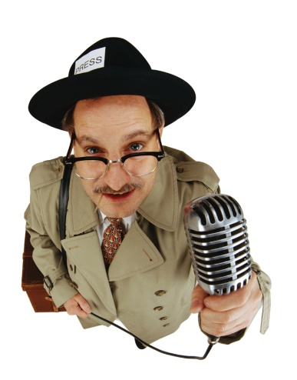
3Ps
Perspective
_________________
_________________
Process
_________________
_________________
Problems
_________________
_________________
Notes
What is the number one reason most often sited by people to explain how things go wrong?
_______________________
Texas Juvenile Justice Department
www.tjjd.texas.gov

Slide 17
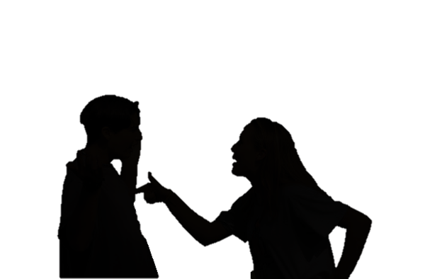
Handling the Crisis
Notes
Bring in _____________ persons involved in the conflict
Line up the Facts
Never reprimand while _____________
Be precise about the offense
Get the _________ person’s side of the story
Be sure to document
Don’t ___________ a grudge!
Texas Juvenile Justice Department
www.tjjd.texas.gov

Slide 18
Action Plan
On behalf of the
Texas Juvenile
Justice Department
Thank You for your participation.
Please help us to create more effective training opportunities by completing any evaluations.
Texas Juvenile Justice Department
www.tjjd.texas.gov

